Slide 1
CI – DevOps Demo

Slide 2
Introduction
Continuous integration is a process in which all development work is integrated as early as possible. The resulting artifacts are automatically created and tested. This process allows to identify errors as early as possible.
Jenkins is a popular open source tool to perform continuous integration and build automation. The basic functionality of Jenkins is to execute a predefined list of steps, e.g. to compile Java source code and build a JAR from the resulting classes. The trigger for this execution can be time or event based. For example, every 20 minutes or after a new commit in a Git repository.

Slide 3
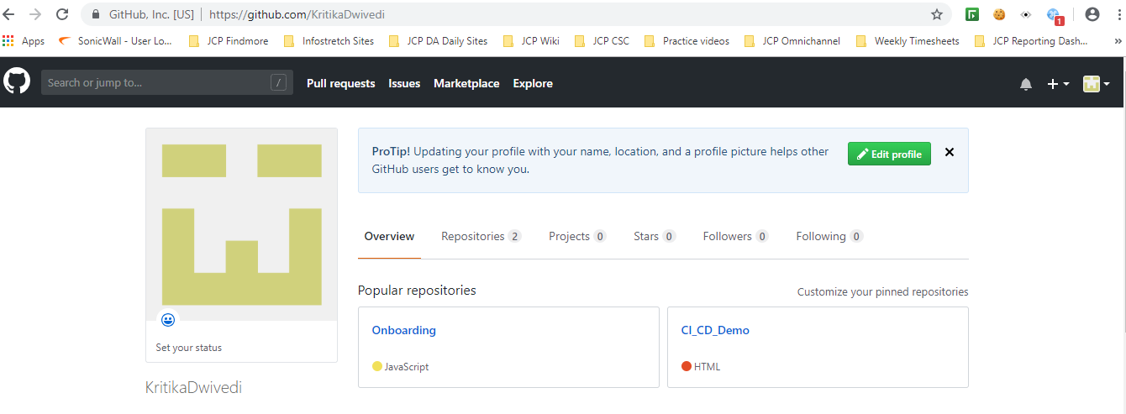
Steps for Continuous Integration
Create a repository in Github : CI_CD_Demo

Slide 4
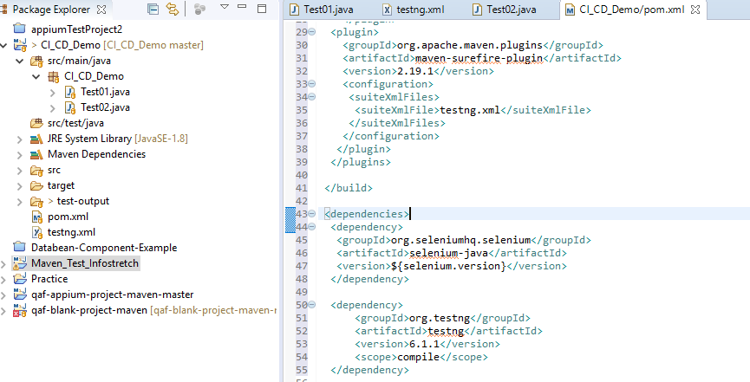
Create maven project in eclipse : CI_CD_Demo
Add dependencies and plugins in pom.xml

Slide 5
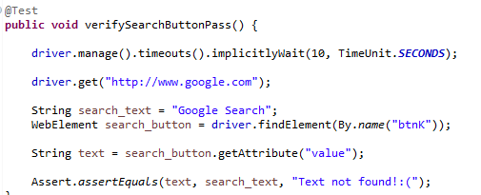
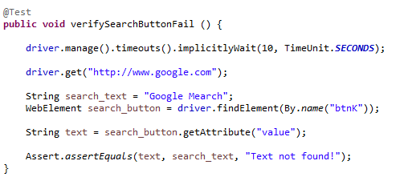
Create sample tests classes:
Test01.java Test02.java
Commit and push the code in Github:
https://github.com/KritikaDwivedi/CI_CD_Demo.git

Slide 6
Jenkins Installation and Set Up
Download Jenkins war file
On Command Prompt enter java –jar jenkins.war
After installation, open a browser and connect to it using url : http://localhost8080/
You will need to copy the initial password from the file system of the server
Create an admin user and press Save and Finish.
Tool Configuration: Specify maven installation
Then, open jenkins server and go respectively: Manage Jenkins> Global Tool Configuration > Add Maven
Select installed maven version on your pc, give a name and save.

Slide 7
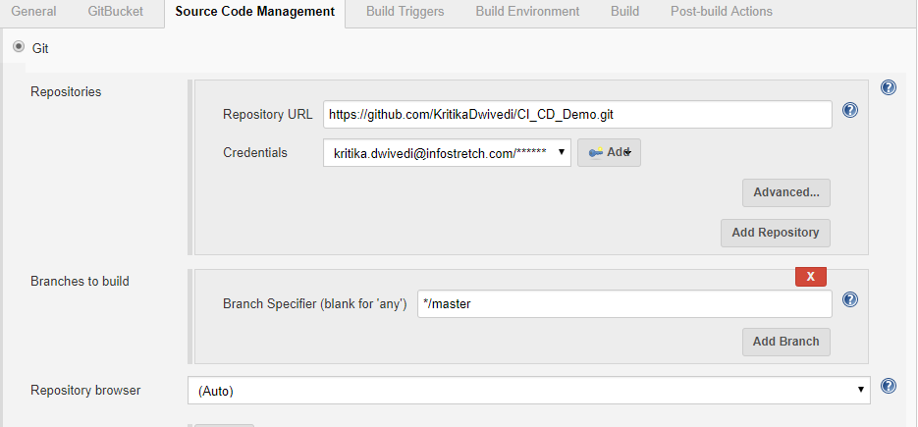
Create new job and integrate with github
On jenkins dashboard click New Item >Freestyle Project and name the project
Job configuration page will be opened
In the Source Code Management section, select Git
For repository url; enter project url on github like
Secondly, add credential for this github account (username and password for github account)

Slide 8
Select Build Trigger option
Go “Build Triggers” section
Check Poll Scm and enter five stars with spaces (* * * * * )
It means “every minute” for cron time process. So our jenkins server will check github every minute, if there is any change in the repo it will trigger the job and tests will start. You can set trigger time however you want using cron time.
Select Build Option
Go “Build” section
Click “Add Build Step” button
Select “Invoke top-level maven targets”
For maven field, select specified maven version before
For goals field, enter mvn commands to run testng tests.

Slide 9
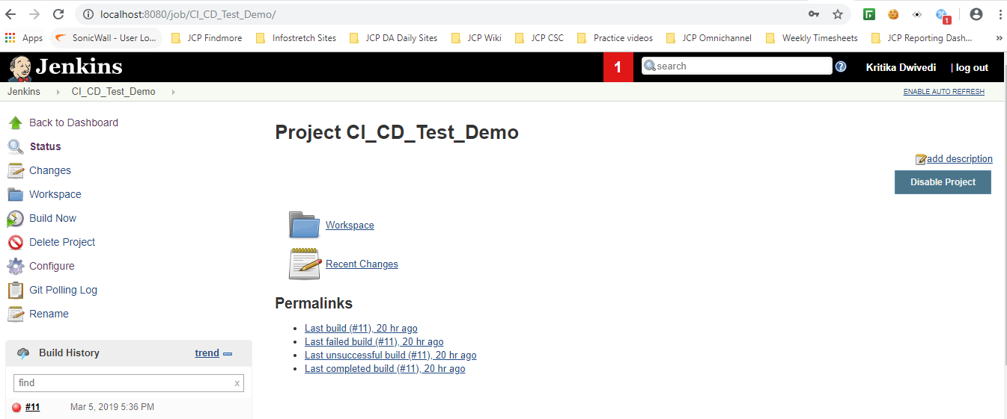
Now, our github integrated CI server is ready. You can start job manually from jenkins or you can push any commit to the repo that you specified in the project and jenkins starts the job instead of you.

Slide 10
Thank You

